Slide 1
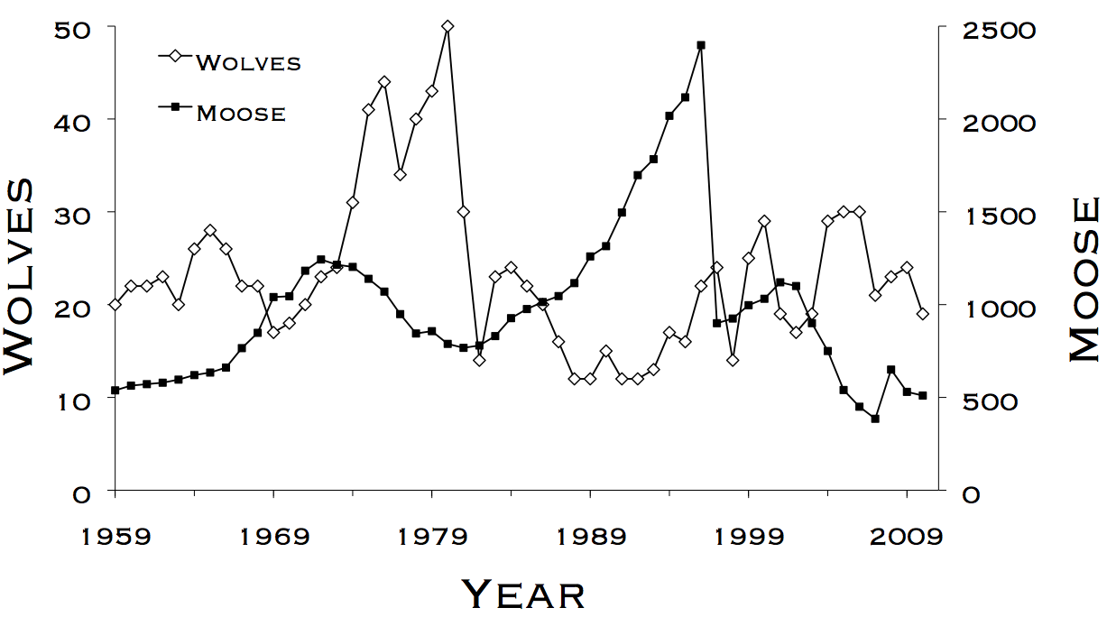
Welcome to WLE 411!
Fill out a name tag (pronouns optional)

Slide 2
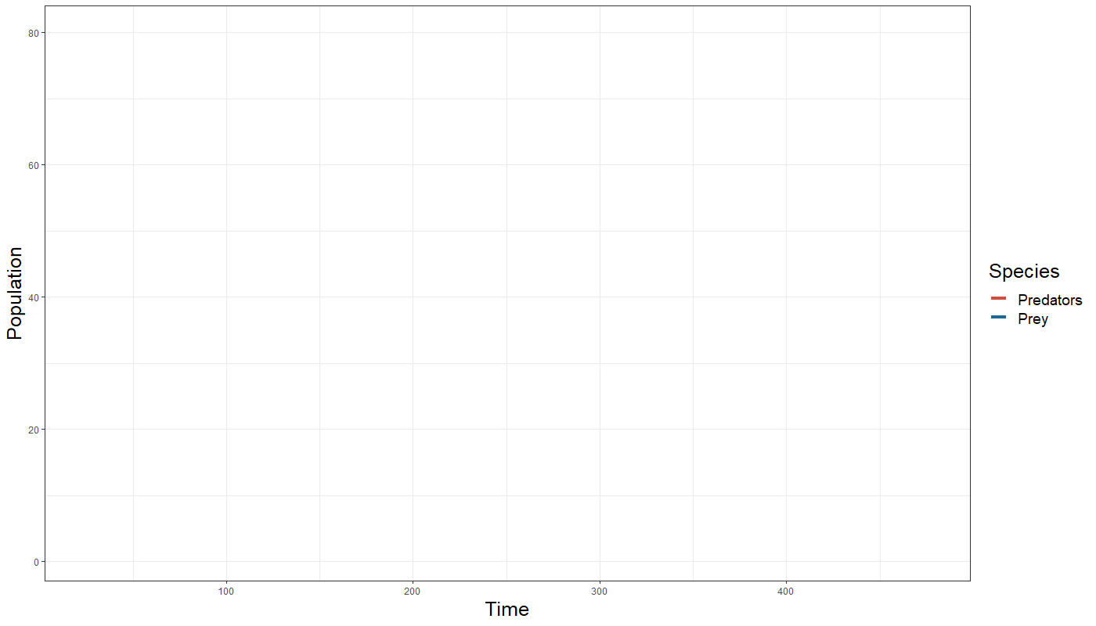
What drives abundance and population trends?
Notes:
Real quick, a little bit of background
When conducting wildlife management, pretty much everything we do is centered around population abundance and trends in population size
Is this habitat occupied?
Is an endangered species declining, or recovering?
These are useful questions to answer, but often we’re concerned with the causes behind population trends
Are declines driven by low survival, low reproduction, or both?
What covariates, such as habitat quality or weather, might be affecting survival or reproduction?
This is how we get at the root causes of wildlife decline, and will be the focus of WLE 410 & 411
More about doing than listening to me talk

Slide 3
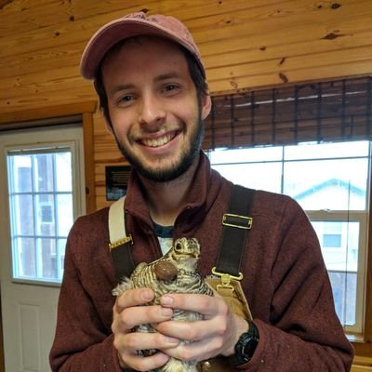


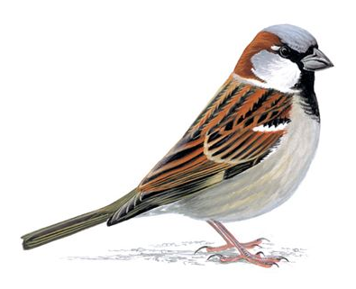
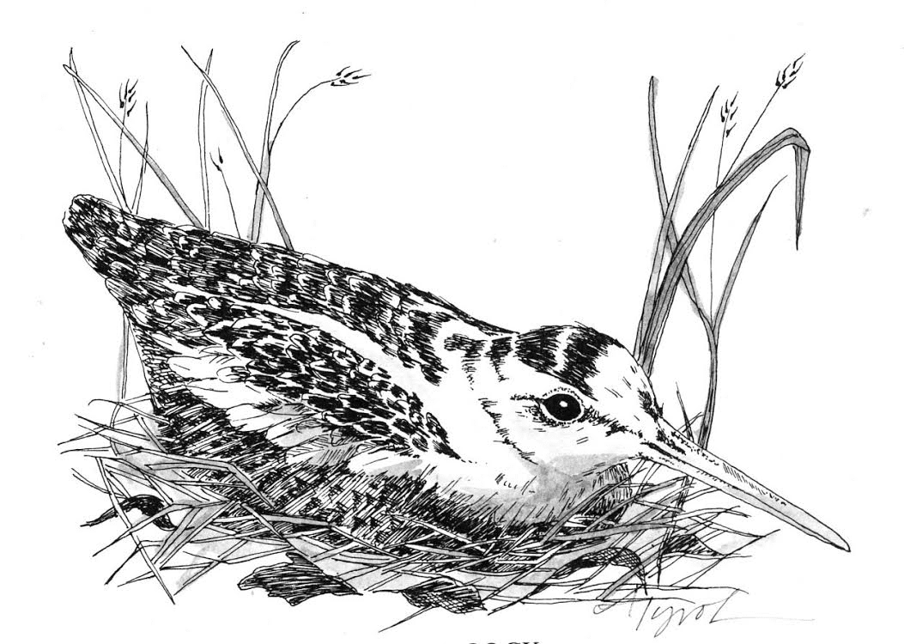

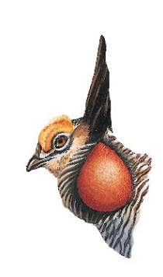
Liam Berigan (he/him)
2013 – 2017
2020 – present
2017 – 2019

Slide 4
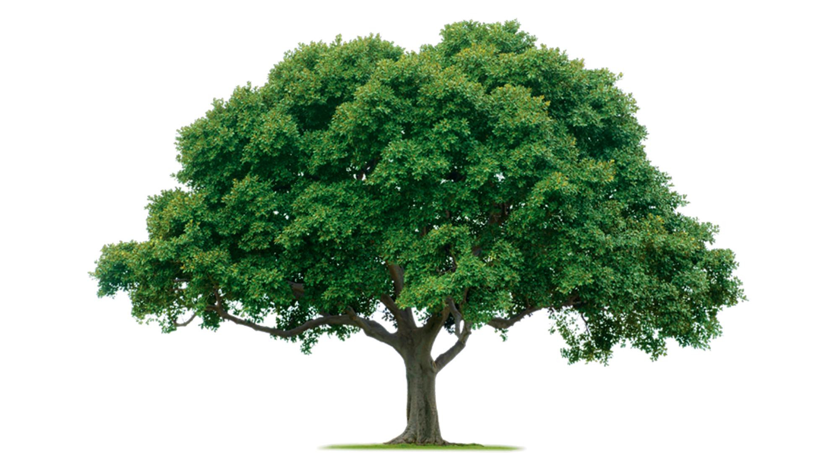

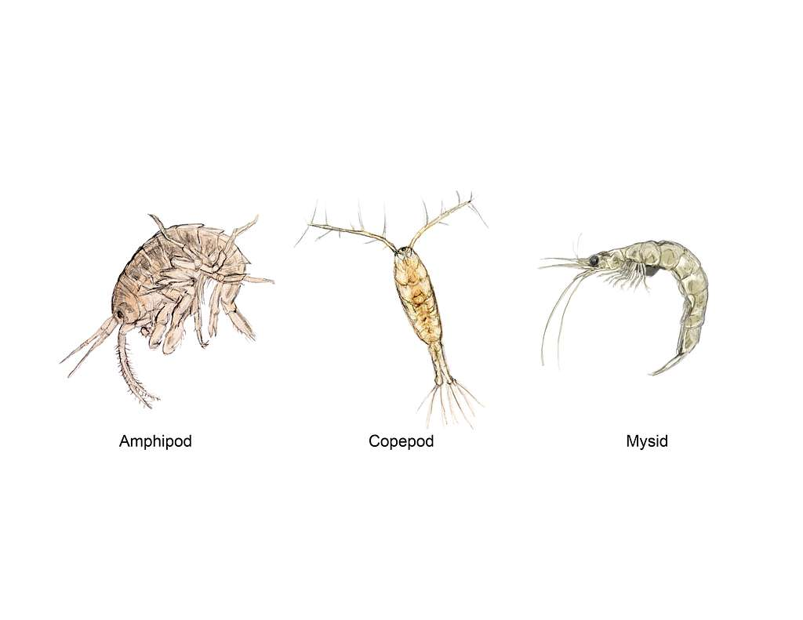
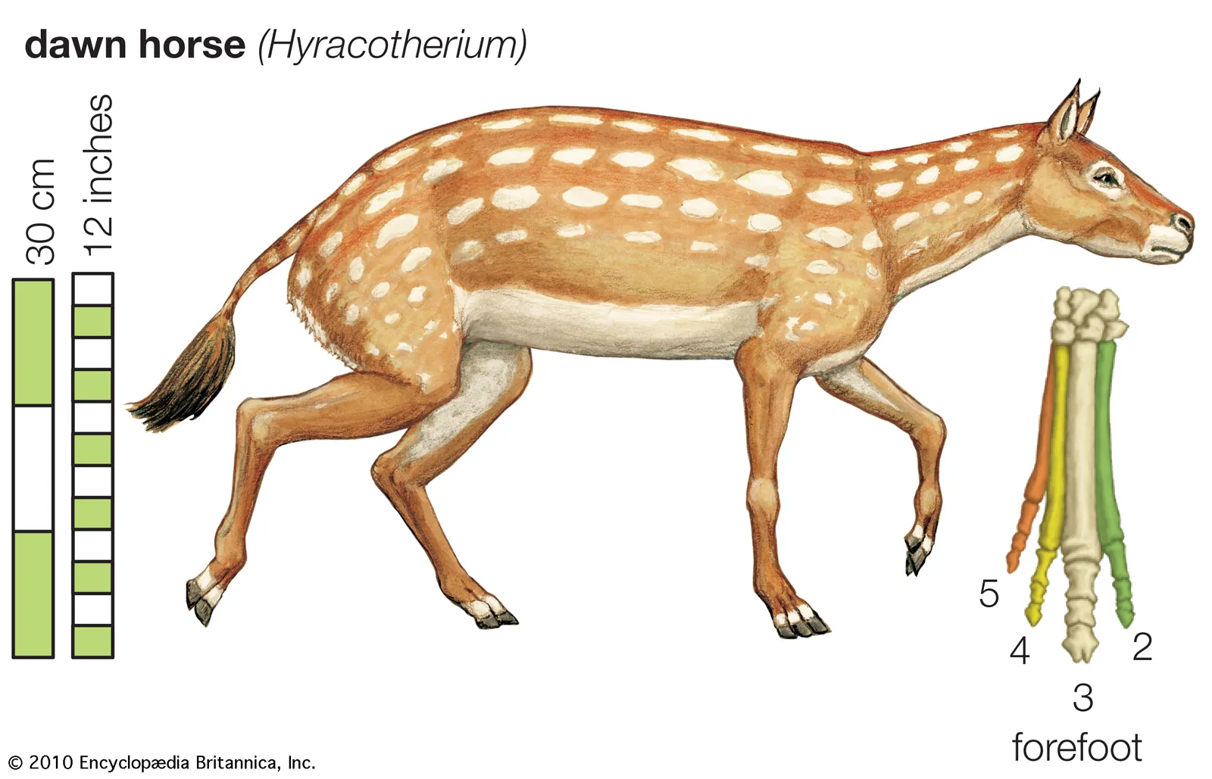
Marcos
J. Marcos Rodríguez
2016-2020

Slide 5
Learning objectives
Design wildlife field studies that are useful for population monitoring and analysis.
Apply quantitative methods to estimate animal abundance, survival, and population growth, and interpret the results of those analyses.
Have a greater familiarity with computer software commonly used for wildlife population analysis.
Critically assess others’ work and provide constructive suggestions in these areas.

Slide 6
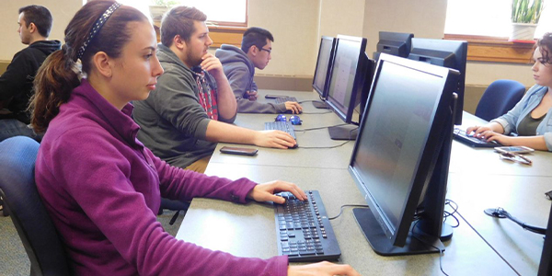
Lab structure
5 – 10 minute lecture at the beginning of lab
Rest of the period- work through the lab manual
Support from peers and instructors

Slide 7
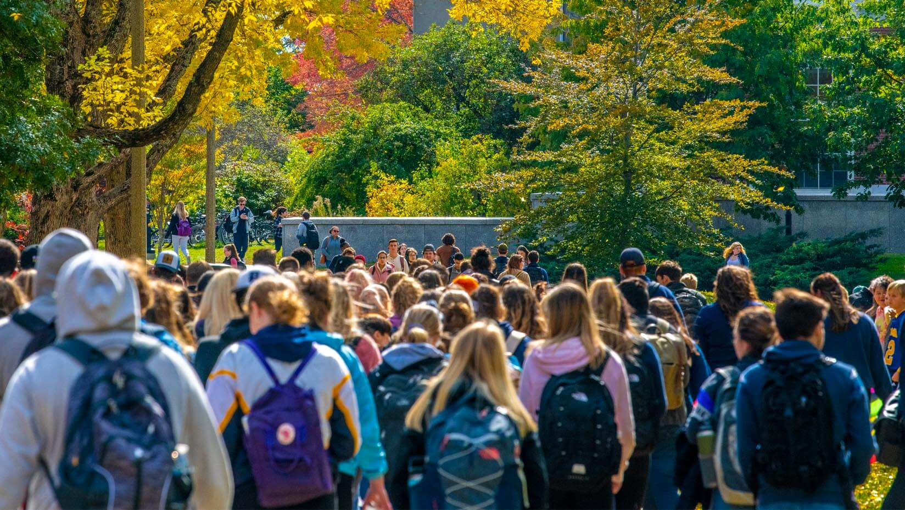
Attendance
Honor system
If absent:
Email Liam (preferably before)
Work through lab manual individually
Support through office hours

Slide 8
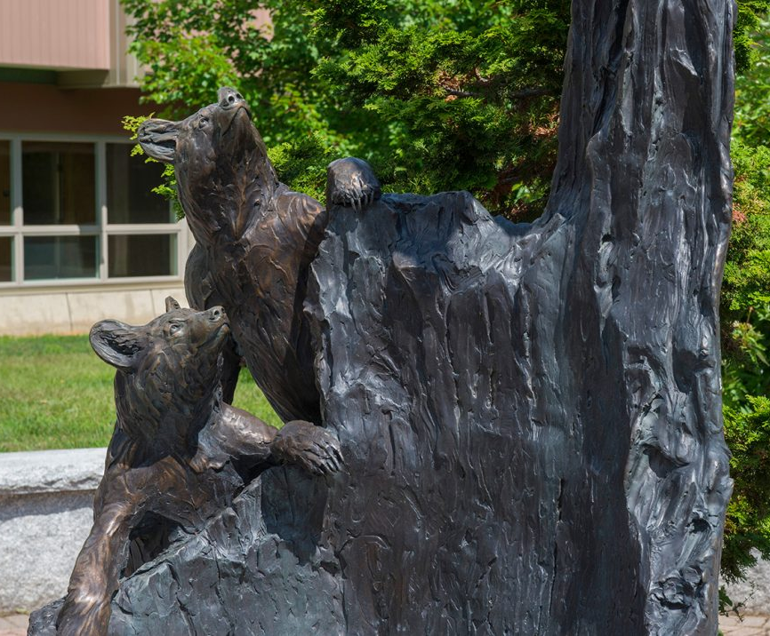
Office hours
Liam
Thursdays 1 to 2 pm, 232 Nutting
Marcos
Wednesdays 9 to 10am, 220 Nutting
Bring a laptop or USB drive if you’re having code issues

Slide 9



Software
Programs:
Microsoft Excel
R & RStudio
Program MARK
Recommend using lab computers
Works on most personal PCs
MARK will not run on modern Macs

Slide 10
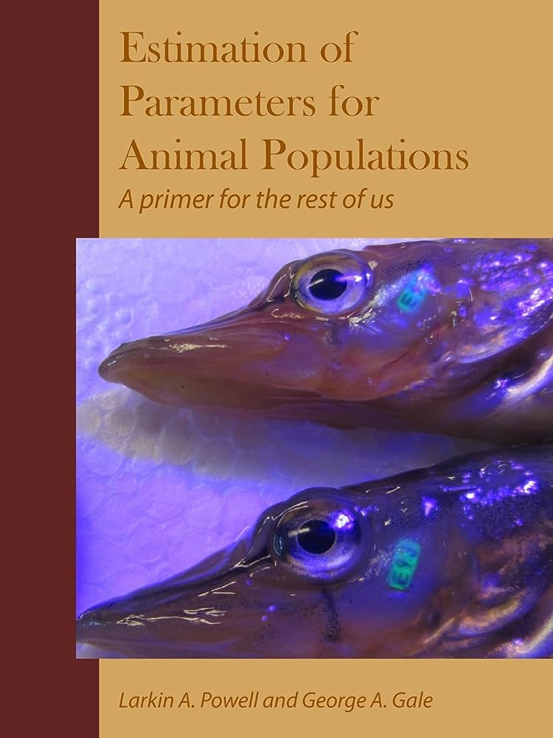
Reference text
Estimation of Parameters for Animal Populations
Powell & Gale
Free online
Weekly assignments in the syllabus
The lab manual focuses on how, the reference text focuses on why

Slide 11
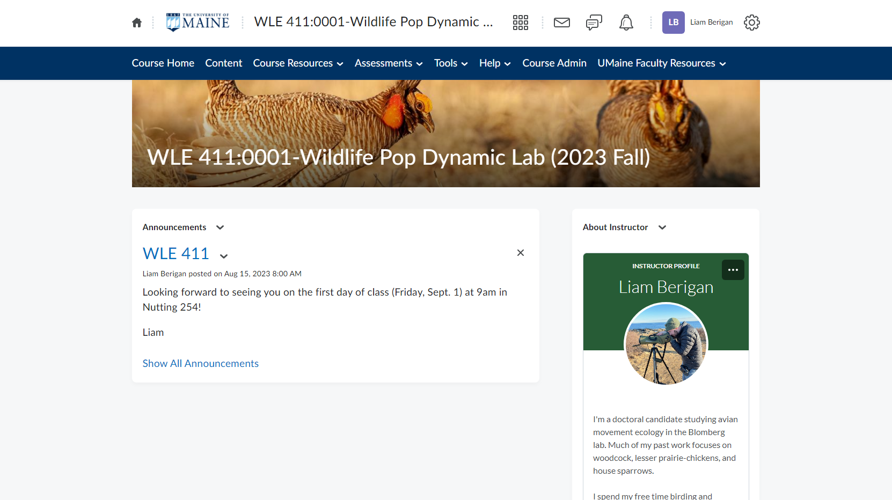
Brightspace
Notes:
Paper-free course
Documents, assignment submission, and grading are all via Brightspace
If you can’t get in, let me know ASAP

Slide 12

Grading
10 assignments, 15 points each
Due at the beginning of the subsequent class
See Brightspace for dates
Late assignments receive penalties
2 revisions per semester (via email)
Contact:
Liam for extensions
Marcos for grading questions, revisions
Notes:
No tests, no attendance

Slide 13

Accessibility
Accommodations
liam.berigan@maine.edu
Student Accessibility Services
um.sas@maine.edu
Religious holidays
Email Liam if missing class
Support services
umaine.edu/wellness

Slide 14
Academic honesty
Academic honesty is very important. It is dishonest to cheat on exams, to copy term papers,
to submit papers written by another person, or generated by software or systems without
the explicit approval of the instructor, to fake experimental results, or to copy or reword
parts of books or articles into your own papers without appropriately citing the source.
Students committing or aiding in any of these violations may be given failing grades for an
assignment or for an entire course, at the discretion of the instructor. In addition to any
academic action taken by an instructor, these violations are also subject to action under
the University of Maine Student Conduct Code. The maximum possible sanction under
the student conduct code is dismissal from the University. Please see the University of
Maine System’s Academic Integrity Policy listed in the Board Policy Manual as Policy 314:
https://www.maine.edu/board-of-trustees/policy-manual/section-314/

Slide 15

Academic honesty
Collaboration on assignments is encouraged
Asking questions, debugging code, etc.
However, all submitted assignments should be unique
No copy-pasting your lab mate’s code

Slide 16
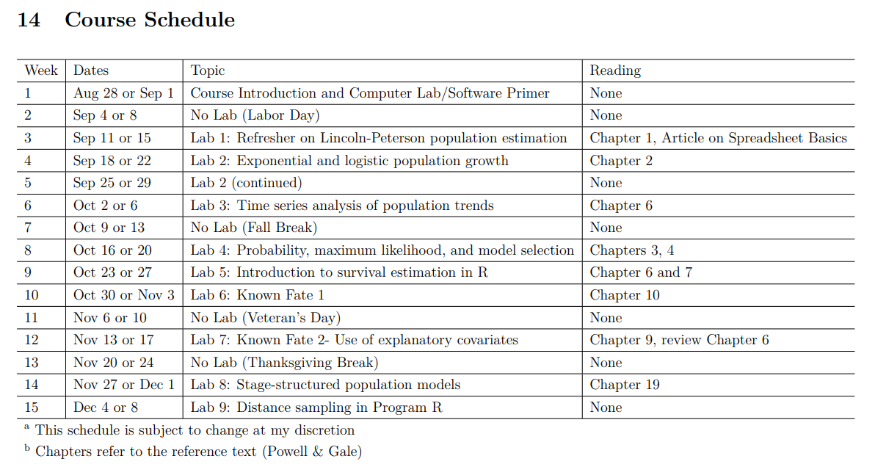

Slide 17
